Slide 1
Lecture 23
Nick Rugai PhD

Slide 2
Debugging
There are 3 kinds of errors:
Syntax:
Caught by the interpreter.
Runtime:
While the program is running.
Semantic:
Programs runs but it’s buggy.

Slide 3

Syntax Errors
Syntax errors are easy to detect.
The Python messages are not very informative.
Most of the time the exact line is provided.
Build the program incrementally, so if there is an error it lays on the last few lines.

Slide 4
Syntax Errors
Using Python keywords as variables
Missing the colons.
Missing matching quotes when using strings.
Missing matching parenthesis.
= vs. ==
Wrong indentation.

Slide 5
Syntax Errors
You checked the code several times and you know the code is awesome but you still get errors!
Sometimes the interpreter is looking at a different program!
Check the environment!
Save the file!
Check the name of the file.
Using an import with the same name as a Python library file.
Save, Shut Down, Reload!

Slide 6
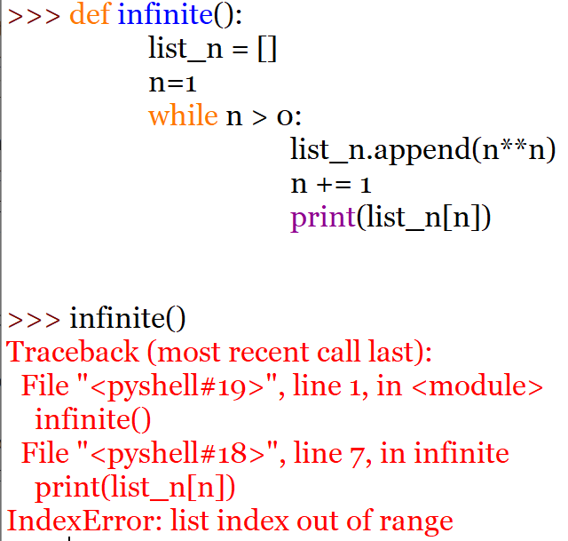
Runtime Errors

Slide 7
Runtime Errors
Program does nothing.
Forgot to call the main function or did not instance a class.
Program hangs:
Loop issues: use printout before loops (‘Entering loop’, ‘Exiting loop’)

Slide 8
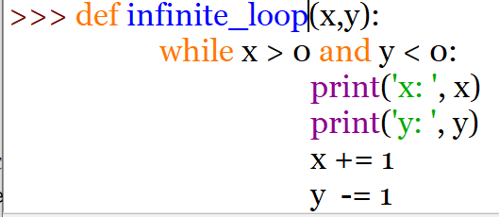
Runtime Errors
Infinite Loop:

Slide 9
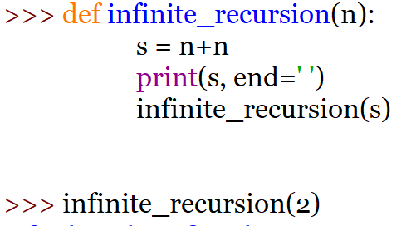
Runtime Errors
Infinite Recursion:
You must provide a out!
Make sure you have a condition to escape.
Use flow of execution and print statements!

Slide 10
Runtime Errors
Exceptions errors:
Easier to debug because Python tells you the location.
NameError: The variable does not exist, wrong name or spelling.
TypeError:
Using a string as int.
Miss-match in string formatting.
Passing an invalid number to a function.
Key Error: Trying to access a key in a dictionary that does not exist.

Slide 11
Runtime Errors
AttributeError:
The method does not exist, wrong name or spelling.
NoneType, check the proper instance and constructor
Check return statements. If you are returning none, that could be the problem.
IndexError: If the index is greater than the list length minus 1, you’ll have issues.
Don’t forget to comment out or delete the print statements used for debugging or you’ll end up with tons or printouts!

Slide 12
Semantic Errors
Hardest to debug.
Use print statements.
Insert or remove breakpoints.
Stepping the programs.
Compartmentalize the program.
Must find where the problem is in the code.
Clean up lengthy complicated expressions.

Slide 13
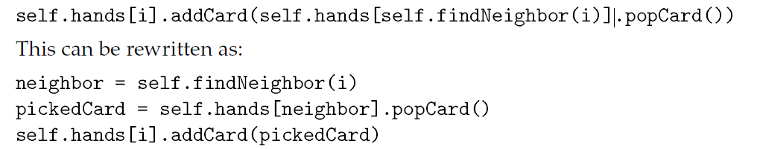
Semantic Errors
Simplify the code as much as possible:

Slide 14
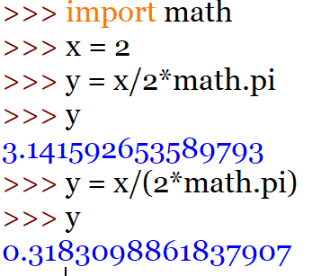
Semantic Errors
x/2*pi
Keep your return statements simple if in doubt.

Slide 15
Semantic Errors
Eventually you will experience frustration and rage.
Belief that the computer really hates you.
The ghost in the machine.
Take a break, walk out of it, reevaluate and a later time.
Get a new pair of eyes on the program if necessary.

